Slide 1
B Tech. IT, V Semester mini project
Under Supervision of Prof. Anupam Agarwal
Topic : Face Emotion Recognition using Biorthogonal Wavelet Entropy and Support Vector Machine.
Group Members :
Prabhat Singh(IIT2015057)
Yash Gupta (IIT2015072)
Akash Kumar (IIT2015084)
Saurabh Singh(LIT2015013)
Rahul Kumar (LIT2015023)

Slide 2
WHAT IS FACIAL EMOTION RECOGNITION?
Facial Emotion Recognition is process of identifying human emotions through facial expressions . It is natural and automatic for humans but for computer some methodologies need to be developed.
Academically ,the facial expression denotes motions and positions of facial muscles beneath skin of the face.

Slide 3
WHY FACIAL EMOTION RECOGNITION?
Most Reliable and Efficient
Human Robot Interaction
Find Emotion Of Audio less Video
Medical Practices

Slide 4
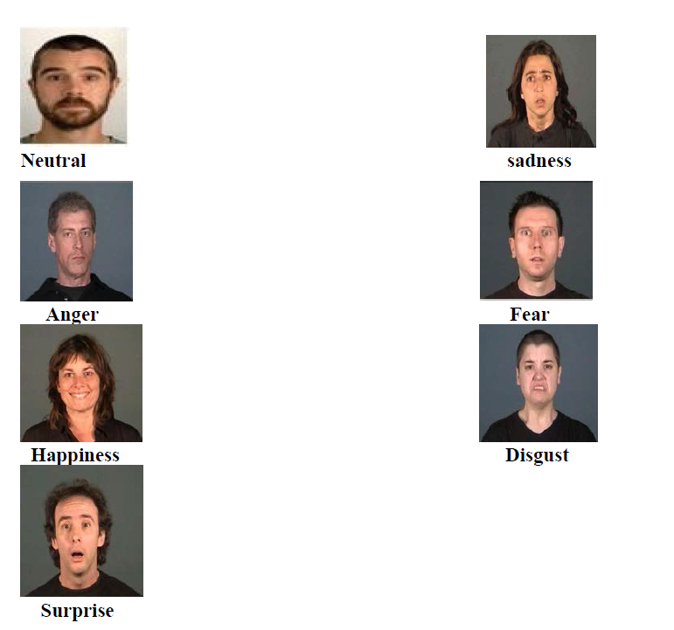
Facial Expressions

Slide 5
OBJECTIVE
This project aims to come up with a solution to the “Facial Emotion Recognition” problem. It uses Biorthogonal Wavelet Entropy for feature extraction. This method is composed of the advantages of both Biorthogonal Wavelet Transform and Shannon Entropy. Moreover, this project uses a compelling variant of Support Vector Machine (SVM).

Slide 6
DWT
Sampled signal .
Passes through low-pass and high-pass filter .
Followed by down sampling by 2 .
Get approximation coefficient .
1d – C_{l} , C_{k} .
2d – C_{a} , C_{d} , C_{h} , C_{v} .

Slide 7
WHY NOT DWT ?
Disadvantage of DWT
Advantages of BWT
Complex calculation .
Too many feature to handle .
Provides more degree of freedom.
Associated WT is orthogonal .

Slide 8
Support Vector Machine
Support Vector Machines are supervised machine learning
algorithms.
It is mainly used for classification problems.
It takes a set of data(training data) as input and outputs
the choicest hyperplane which classifies the given input data
into two classes.
The generated hyperplane is used to categorize new data.

Slide 9
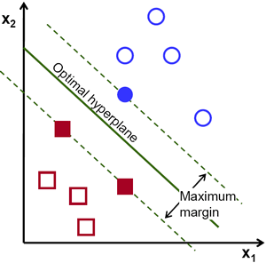
Support Vector Machine

Slide 10
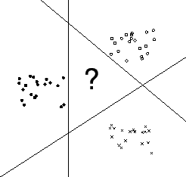

Slide 11
Multiclass Support Vector Machines (MSVMs)
SVM is generally used to solve binary classification problems.
For solving Multiple classification problems we use a multiclass SVM.
This multiclass SVM is also called one-against-all SVM.
Winner-takes-all approach is applied for solving these
problems.
The class with maximum score will be chosen.

Slide 12
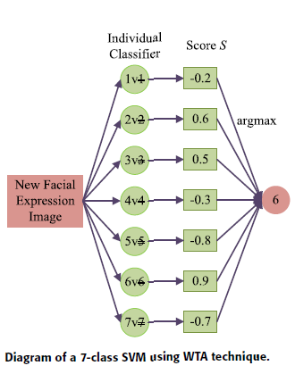
Multiclass Support Vector Machines (MSVMs)

Slide 13
Methodology
We need to recognize a facial expression among seven different emotions: happy, sadness, surprise, anger, disgust, fear, and neutral from facial expression images.
We will employ biorthogonal wavelet entropy to extract multiscale features.
Use multiclass support vector machine to be the classifier.

Slide 14
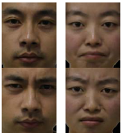
Feature Extraction (Biorthogonal Wavelet Entropy)
Feature Classification ( Support Vector Machine)
EMOTION RECOGNITION
Methodology Flow chart

Slide 15
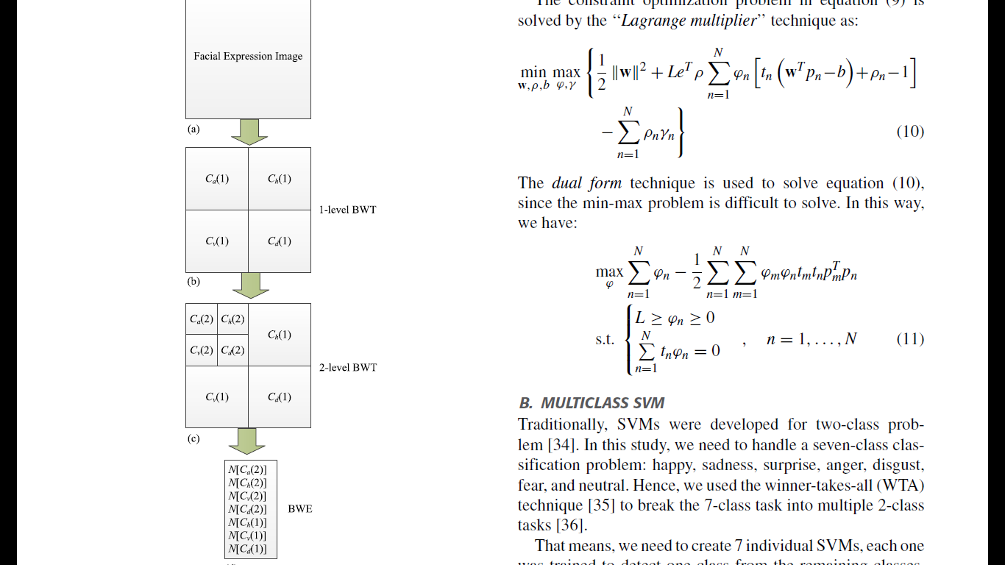
Block Diagram of a 2-level BWE: (a) A facial expression image (b) 1-level BWT (c) 2-level BWT Shannon entropy calculation. In this figure, (j ) represents the j -level decomposition.

Slide 16
Feature Extraction :

Slide 17
Hardware and Software Requirements :
Software requirement:
▪ MATLAB 2012 or above ▪ Wavelet Toolbox ▪ Image Acquisition Toolbox
Hardware requirement:
▪ Minimum 4 GB RAM ▪ Webcam

Slide 18
Datasets
Benchmark dataset: JAFFE
Dataset created by our group

Slide 19
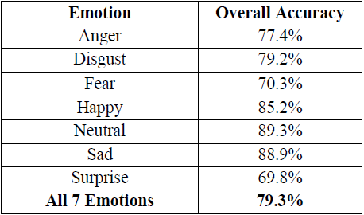
Results
On All 7 Emotions :

Slide 20
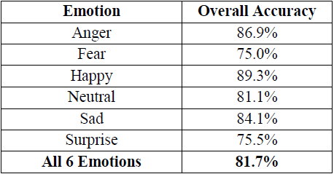
Results
On 6 Emotions(excluding Disgust) :

Slide 21
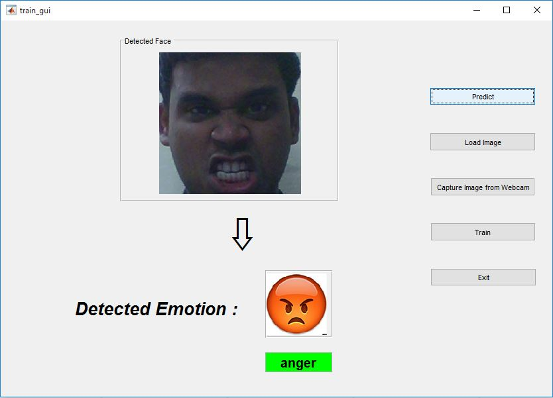
Demo

Slide 22
Future Scope
Mixed Emotions
Music Systems
Incorporate physiological features like heart-beat rate

Slide 23
THANK YOU

